Slide 1
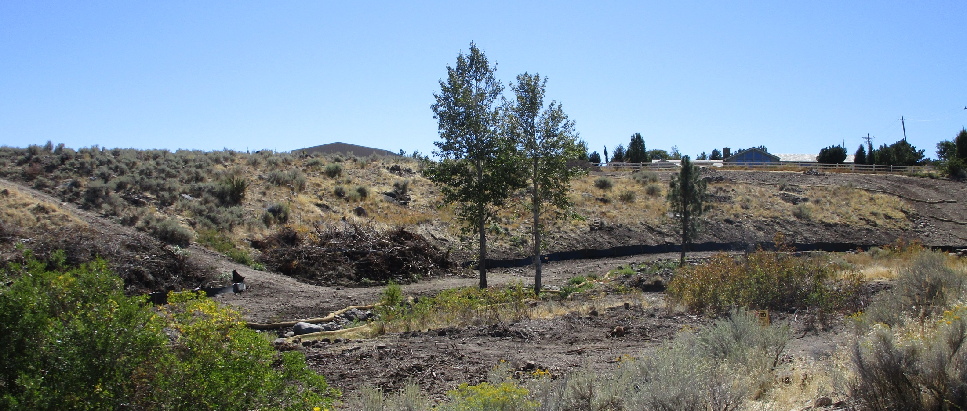
WSUP18-0017 Soule Grading
Washoe County Board of Adjustment
October 4, 2018

Slide 2
Request
The application is seeking approval of a special use permit from the Board of Adjustment for after-the-fact grading done without appropriate permits within the Critical and Sensitive Stream Buffer Zones as defined in Article 418, Significant Hydrologic Resources of the Washoe County Development Code.

Slide 3
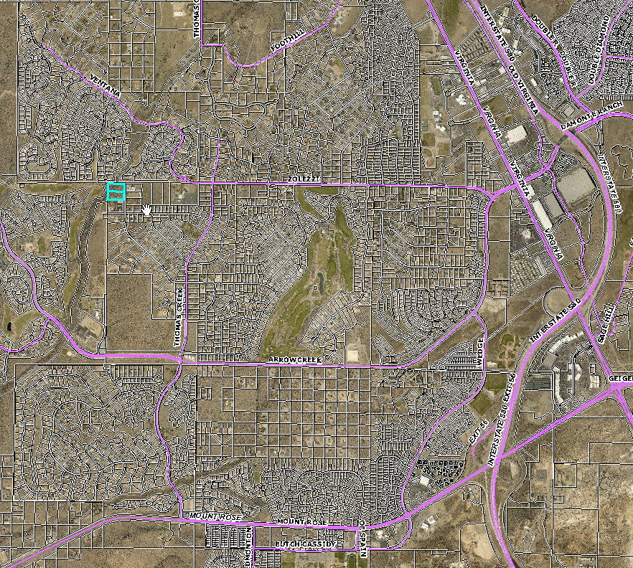
Project Site

Slide 4
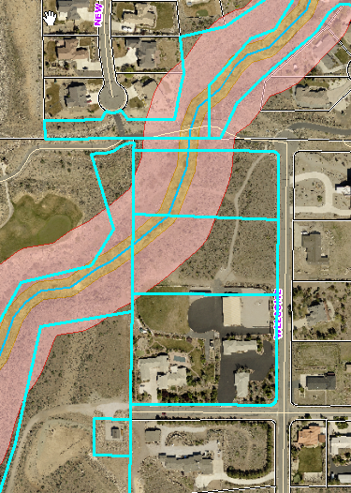
Scott Hume parcel
Southwest Vistas HOA parcel
Grading site
Washoe County parcel
Soule house
Sage Ridge School parcel
TMWA parcel

Slide 5
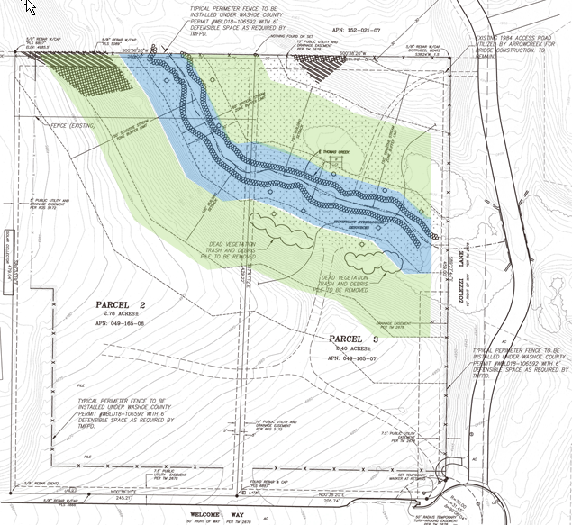
Existing vegetation
Piles of dead vegetation
Perimeter fence

Slide 6
Development Code Background
Article 438, Grading is defined as, “any clearing, excavation, cutting, filling, or other disturbance of the natural state of the landform or natural vegetation and/or any combination thereof.”
Article 418, Significant Hydrological Resources, regulates the development activity within and adjacent to perennial streams to ensure that these resources are protected and enhanced.
Thomas Creek is defined as a perennial stream per Significant Hydrological Resources Map 110.418.05.1 and is identified as a U.S. Waterway by the federal government.

Slide 7
Code Enforcement Activity
In May a complaint was received for grading in the property and Code Enforcement Officer spoke to property owner and was told that only dead and dying vegetation was being removed
On June 12th a Stop Work Order was issued after another complaint was received
On June 21st Washoe County staff met with the property owner and explain the violation and it was concluded that the property owner would apply for a special use permit (SUP)

Slide 8
Background
On July 30th the property owner applied for a SUP
On July 26th the property owner obtained a fence permit, (WBLD18-106592) to fence the perimeter of the property
On August 24th staff visited the site and saw that vegetation had been cleared on the east side of the Creek and grading had also, been done along the perimeter of the parcel. According to the property owner this was to allow for equipment to access the area for the construction of the perimeter fence, however the fence permit did not include grading

Slide 9
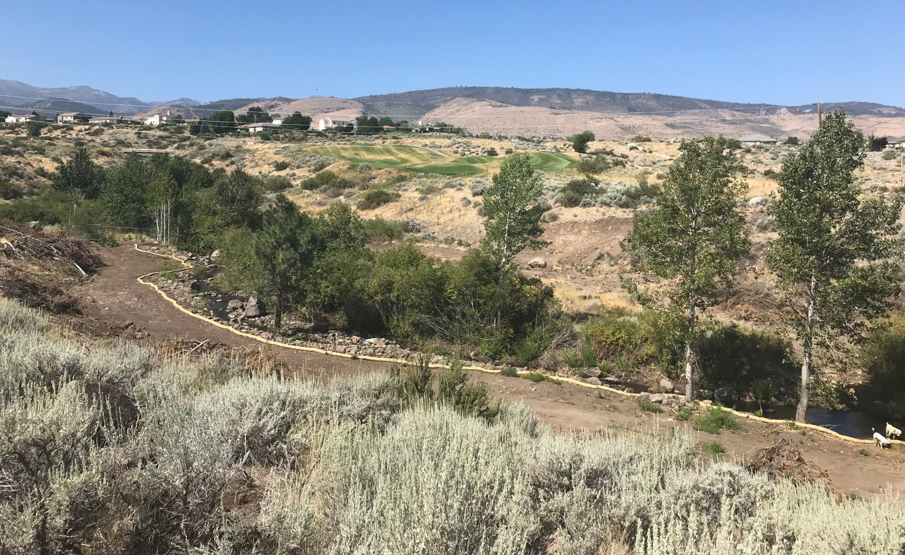
Photo of site on August 24th

Slide 10
Background
Staff received numerous calls and emails after Labor Day weekend stating that the property owner had done further grading along the west side of the Creek
On September 13th an Administrative Penalty Notice and $100 fine was issued for grading that was conducted following the Stop Work Order.

Slide 11
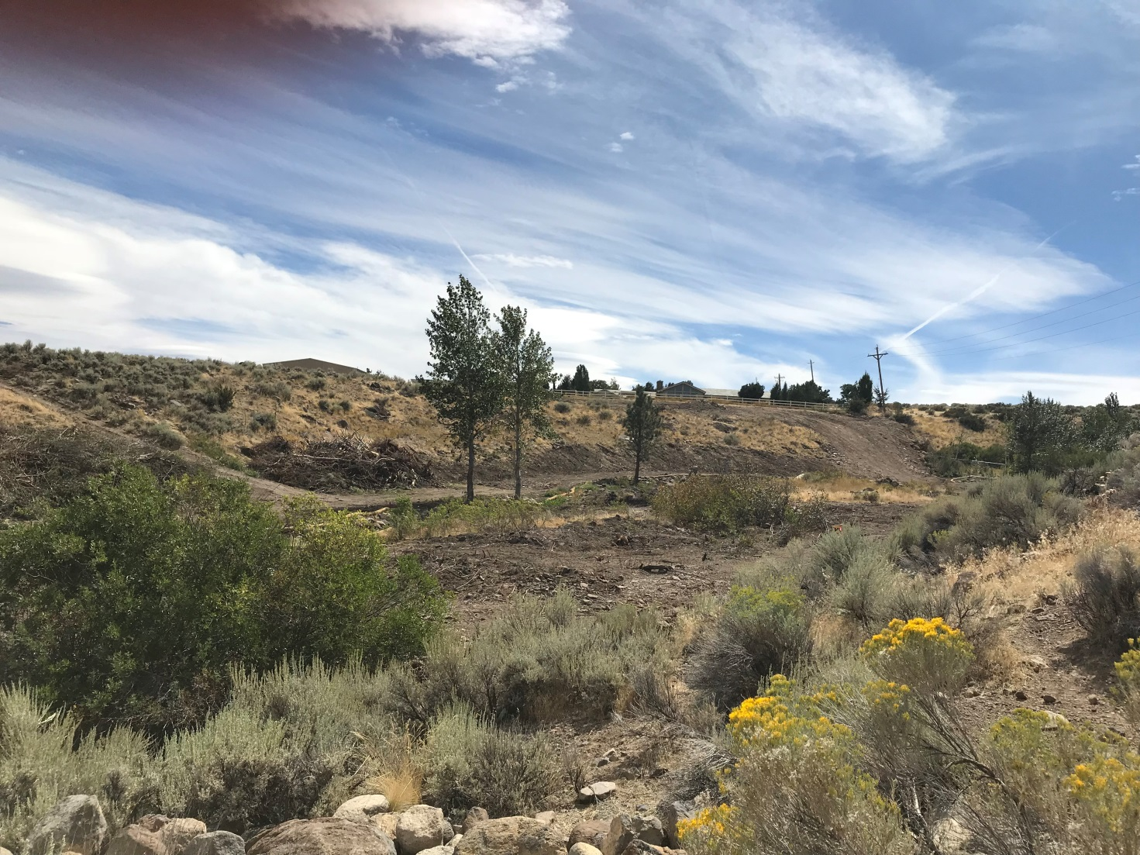
Photo of site on September 12th

Slide 12
Analysis
This site meets Article 438, Grading section for a special use permit for major grading for the:
“Any grading in the Critical Stream Zone Buffer Area (CSZBA) of any Significant Hydrologic Resource (SHR) as defined by Article 418, Significant Hydrologic Resources.”

Slide 13
Analysis
The SUP is the mechanism to correct the cited violation and provides the ability to provide specific direction to resolve the violation- through Conditions of Approval
The SUP process allows staff to send the application to various local, state and federal departments and agencies for review and requested comments and/or conditions, to provide resolution for the violations on site

Slide 14
Reviewing Agencies
Letters, comments and conditions were received from 9 of the 14 reviewing agencies which have been included in the staff report and/or incorporated into the Conditions of Approval
The applicant is currently working with the US Army Corps of Engineers and Nevada Department of Environmental Protection (NDEP) to address issues and meet their requirements

Slide 15
Amending Conditions of Approval
Staff is proposing to amend the Conditions of Approval by removing the conditions from Washoe County Parks and Nevada Division of Forestry (NDF) and provide a new condition under Washoe County Planning and Building as condition f

Slide 16
New Condition
f. The applicant shall develop and submit a restoration plan to the Washoe County Planning and Building Division that includes revegetation with native riparian plant species and measures for erosion and weed control. The revegetation shall protect Thomas Creek and both the critical and sensitive stream zone buffer areas. The plan will include the amount of shrubs and trees, will include evergreen trees at least seven (7) feet in height and deciduous trees e at least two (2) inch caliper, and the pounds per acre of the seed mix. The plan will be submitted with the Building permit for grading. Washoe County Planning and Building Division will consult with Nevada Division of Forestry (NDF) and will be in compliance with the Master Plan policies concerning the appropriateness and viability of the plan for the area to be restored at the project site.

Slide 17
Support for New Condition
The Master Plan Conservation Element’s goals and policies recognize the need for riparian areas and supports protecting riparian community
The Southwest Truckee Meadows Area Plan character statement states “creeks support riparian vegetation and provide habitat for various types of waterfowl and small mammals. Wildlife habitat and migratory routes are a key component of the area’s character “ and “it is essential to protect the delicate natural balance created by these creeks and springs.”

Slide 18
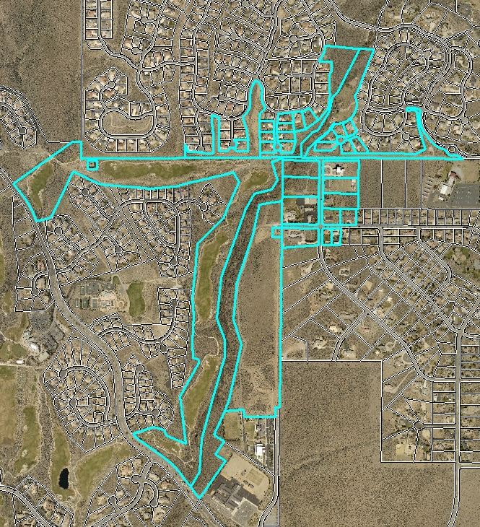
Public Notice & CAB
Notices were sent 500 feet from the site to 35 property owners

Slide 19
CAB Meeting
The South Truckee Meadows/Washoe Valley CAB reviewed the application on September 6, 2018 and 4 members voted in favor of the SUP and 1 member abstained.
The public comments included:
All trees and vegetation along Thomas Creek have been removed whether it was healthy or not and this will increase flooding;
Thomas Creek and the water that flows within it belongs to the community
The area has not been cleaned-up it has been bulldozed and everything has been removed and has destroyed and fish and animal habitat;
The creek has been re-directed and re-aligned and a large pool has been created; and
The property owner has created his own backyard water feature.

Slide 20
Special Use Permit Findings
1. Consistency. That the proposed use is consistent with the action programs, policies, standards and maps of the Master Plan and the Southwest Area Plan.
2. Improvements. That adequate utilities, roadway improvements, sanitation, water supply, drainage, and other necessary facilities have been provided, the proposed improvements are properly related to existing and proposed roadways, and an adequate public facilities determination has been made in accordance with Division Seven.
3. Site Suitability. That the site is physically suitable for outdoor sports and recreation, grading and for the intensity of such a development.
4. Issuance Not Detrimental. That issuance of the permit will not be significantly detrimental to the public health, safety or welfare; injurious to the property or improvements of adjacent properties; or detrimental to the character of the surrounding area.
Southwest Truckee Meadows Area Plan SW.2.14

Slide 21
Possible Motion
I move that, after giving reasoned consideration to the information contained in the staff report and information received during the public hearing, the Washoe County Board of Adjustment approve Special Use Permit Case Number WSUP18-0017 with conditions included in Exhibit A and with the amended conditions as presented, having made all findings in accordance with Washoe County Code Section 110.810.30

